Slide 1
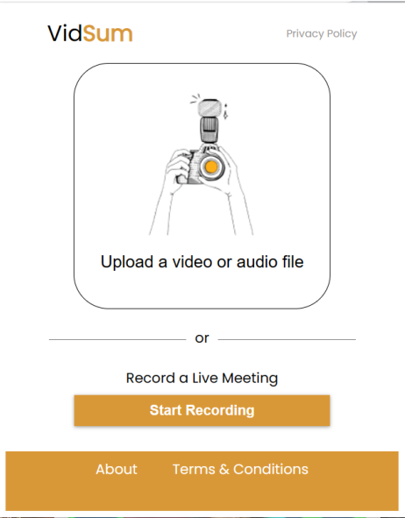
Vidsum - NLP PROJECT
Submitted by : Amogh Garg – 2020UCO1688
Mokshi Sharma – 202UCO1691
Shirishti Jain – 2020UCO1649

Slide 2
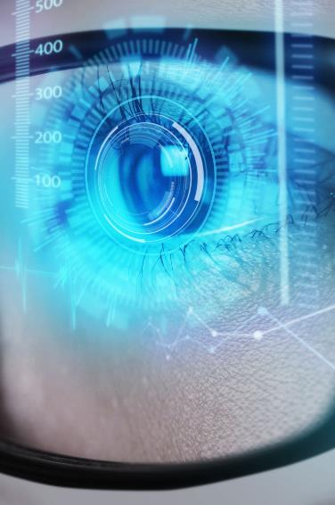
Problem statement
Digital content
Data volume
time
The rise of online meetings, webinars, and video conferences has led to an explosion of digital content.
While these meetings are an essential part of modern communication and collaboration, the sheer volume of data they generate can be overwhelming
It becomes very cumbersome for the people who missed the meetings due to prior engagements to watch the entire recordings again.
Usability
People want something that’s simple to use, efficient and easy to adopt.

Slide 3
Solution
idea
Target audience
Develop an NLP system that can automatically record online meetings, webinars, and videos and generate a summary of the content in text format.
People who miss important webinars can also use this to get a gist of all the things. It can also be used to generate summary of videos for referencing later on.
TIME saving
Easy to use
Saves time by generating summary and preventing the users to go through the entire video. This system can help improve productivity, enhance collaboration, and increase efficiency
Simple to use and user-friendly.

Slide 4
APPLICATION Overview
EXTENSION
API USED
SOCKETIO
Recognizing speech
SPEECH2TEXT
Frontend is in the form of a browser extension. This extension can be used alongside the online meetings/webinars. It will be used to record the meeting and send the recording as input to the backend.
MediaRecorder API is used to record the media stream for which the summary has to be generated.
It is used to establish a bidirectional communication between the client (frontend) and the server (backend). The chunks of video are transmitted from the client to the server for processing using SocketIO.
Speech is extracted from the “video.webm” file using FFMPEG. FFMPEG converts “video.webm” to “audio.wav” which contains just the audio of the entire media.
VOSK Speech2Text model is used to convert “audio.wav” into text i.e convert speech to text. Kaldi submodule under VOSK is used for Automatic Speech Recognition (ASR) from the audio file.
PUNCTUATION
EXTRACTIVE SUMMARIAZTION
FREQUENCY BASED APPROACH
TEXTRANK
This model takes a text file as input and assigns weights to words based on their importance and subsequently assigns scores to sentences based on the weights of the words contained in it. The sentences with scores above a certain threshold are appended to the summary.
This model also takes text files as input and after cleaning the text, it creates embeddings for the words. In accordance with the word embeddings, a similarity matrix of sentences is created. The similarity matrix is then converted into a graph, with sentences as vertices and similarity scores as edges, for sentence rank calculation. Finally, a certain number of top-ranked sentences form the final summary.
Hugging Face Inference API is used to punctuate the text file generated in the previous step
An Extractive summarization model is developed from scratch to generate the summary of the given input file. 2 models have been developed and the results generated by both of them are compared.

Slide 5
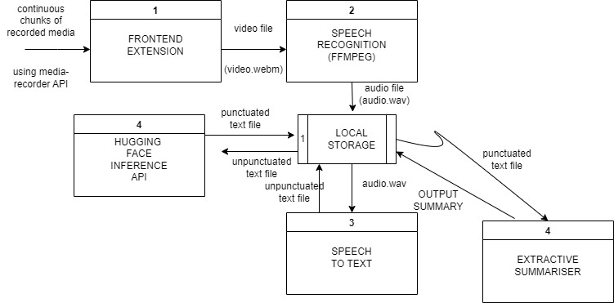
Data flow diagram

Slide 6


TECH STACK USED
FRONTEND​
HTML
CSS
JAVASCRIPT
​BACKEND
PYTHON –
SOCKETIO
VOSK
NLTK
FLASK

Slide 7
TESTING THE SUMMARIZATION MODELS
INPUT TEXT:
Natural Language Processing (NLP) is a field of study that deals with the interaction between computers and human languages. It involves the use of computer algorithms to process, analyze, and understand natural language data. NLP is an interdisciplinary field that draws from computer science, linguistics, mathematics, and psychology. The main goal of NLP is to create machines that can understand and interpret human language, allowing for more efficient communication and data processing.NLP is a complex and rapidly growing field that has many practical applications in various industries. Some of the most common applications of NLP include machine translation, sentiment analysis, speech recognition, chatbots, and text classification. Machine translation involves the automatic translation of text from one language to another, while sentiment analysis involves the analysis of text to determine the sentiment expressed by the author. Speech recognition involves the conversion of spoken language into text, while chatbots are computer programs that can simulate human conversation. Text classification involves the automatic classification of text into different categories based on its content. One of the biggest challenges in NLP is the ambiguity of natural language. Natural language is full of ambiguity, and words can have multiple meanings depending on the context in which they are used. For example, the word "bank" can refer to a financial institution or the side of a river. Resolving these ambiguities requires sophisticated algorithms that can take into account the context and other relevant factors. Another challenge in NLP is dealing with the vast amount of data that is available. The internet has made an enormous amount of text data available, and processing this data requires powerful computing resources and sophisticated algorithms. Many NLP algorithms use machine learning techniques to learn from the data and improve their performance over time.NLP has made significant progress in recent years, and many NLP applications are now widely used in various industries. For example, machine translation services like Google Translate have made it possible for people to communicate across language barriers, while sentiment analysis tools are used to analyze customer feedback and improve product development. Chatbots are becoming increasingly popular in customer service, while text classification algorithms are used in a variety of applications, including spam filtering and content moderation.Despite the progress made in NLP, there are still many challenges that need to be addressed. One of the biggest challenges is improving the accuracy of NLP algorithms, especially in dealing with the nuances of natural language. Another challenge is developing algorithms that can handle multiple languages and dialects, as well as different writing styles and formats.In conclusion, NLP is a fascinating and rapidly evolving field that has the potential to revolutionize the way we interact with computers and process data. NLP algorithms are already widely used in various industries, and their use is expected to grow in the coming years. While there are still many challenges to be addressed, the future of NLP looks 16 promising, and we can expect to see many exciting developments in the field in the years to come.

Slide 8
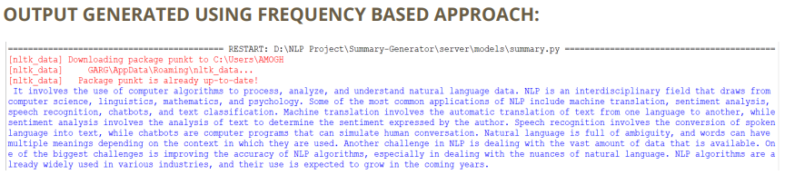
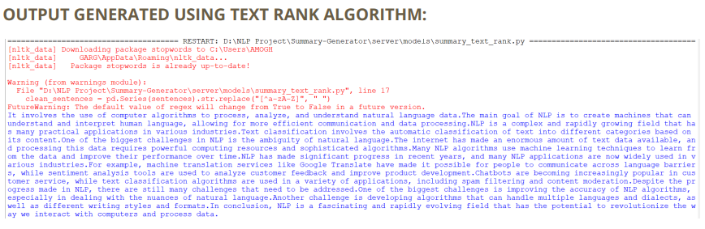
RESULTS

Slide 9

COMPARISON OF BOTH THE MODELS
FREQUENCY BASED​
TEXT RANK
Frequency-based approaches for extractive summarization rely solely on the frequency of words or phrases in the original text to determine which sentences should be included in the summary. Typically, the most frequent words or phrases in the text are used as criteria for selecting the most relevant sentences. This approach does not consider the context or relationships between the sentences.
The output of frequency-based approaches is a summary that consists of the most frequent words or phrases in the text, regardless of their relationships or context.
TextRank algorithm for generating a summary of text uses graph-based ranking to identify the most important sentences. TextRank creates a graph where each sentence in the text is represented by a node, and edges are created between the nodes based on their semantic similarity. Then, the importance of each sentence is determined by its PageRank score, which considers not only the frequency of words but also the relationships between the sentences.
Output of the TextRank algorithm is a summary that takes into account the relationships between sentences and provides a more coherent and contextually appropriate summary of the original text. Therefore, TextRank is generally considered to be a more sophisticated and accurate approach for generating summaries of text

Slide 10
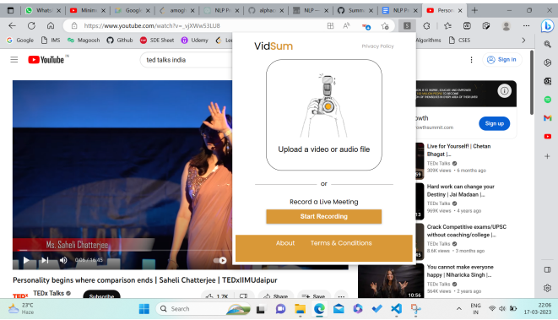
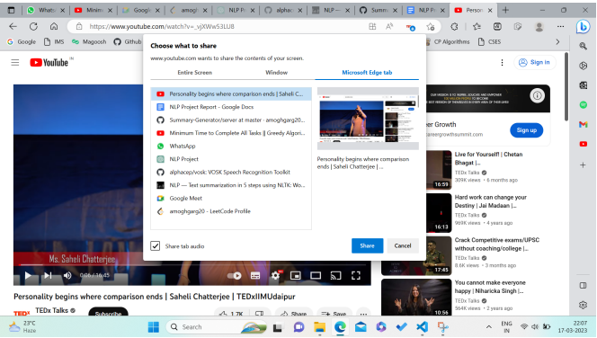
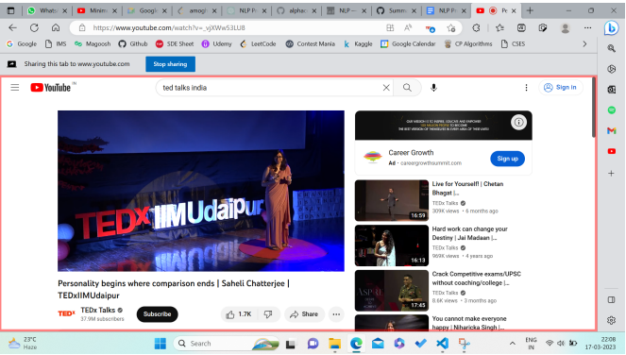
SCREENSHOTS OF APPLICATION

Slide 11
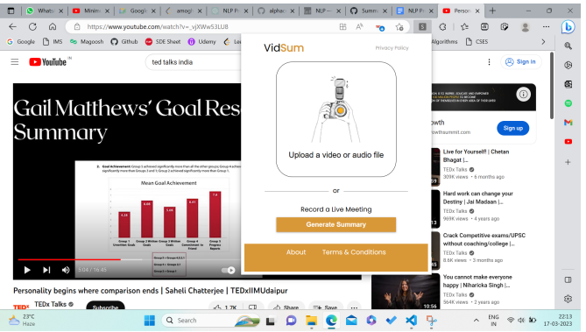
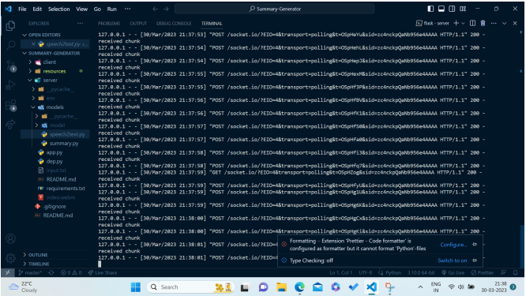
SCREENSHOTS OF APPLICATION

Slide 12
SCOPE OF IMPROVEMENT IN FUTURE
USING OTHER MODEL
OVERCOMING API RESTRICTIONS
Multiple speakers
The system can be tested with other summarization techniques like abstractive summarization to see whether there is improvement in performance or not.
Mechanisms can be devised to overcome limitations of Hugging Face Inference API like latency and recording for limited time.
In future, we can think of solution to recognize multiple speakers in a video and generate summary of each speaker individually.

Slide 13
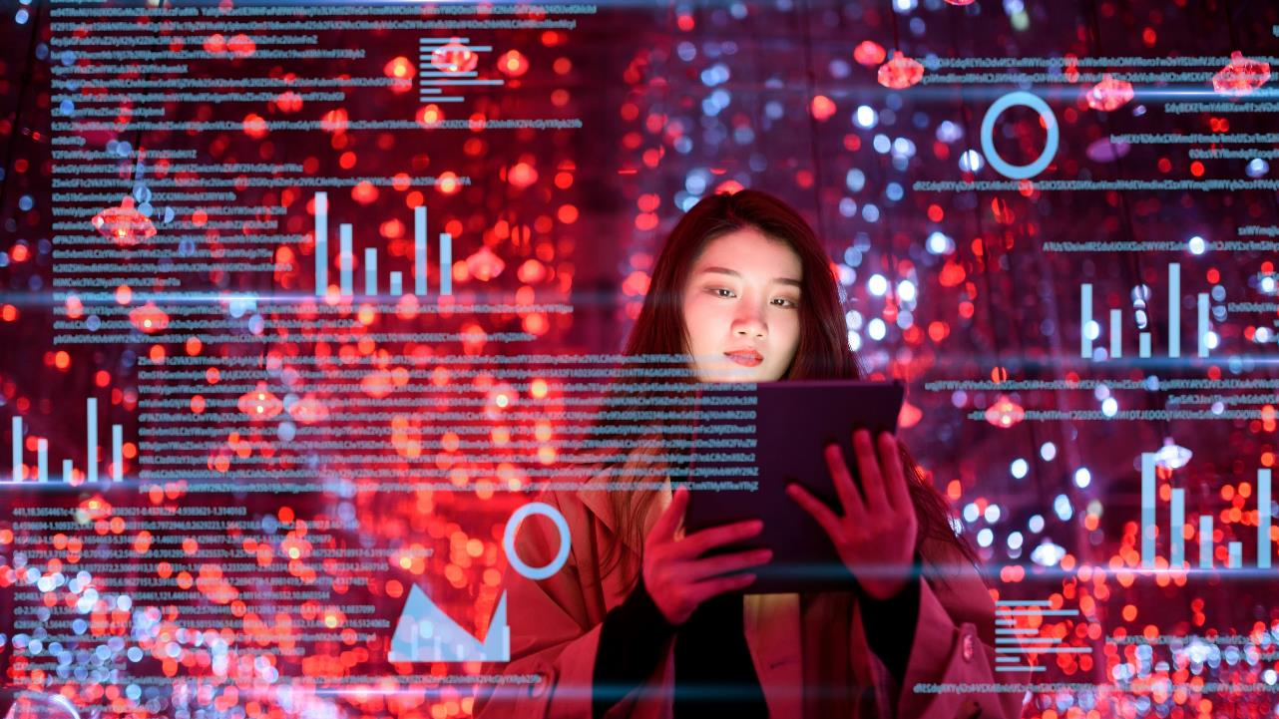
Summary
Overall, the successful development of such a system that can automatically record and summarize online meetings, webinars, and videos will provide significant benefits to organizations and individuals of all types. This system can help improve productivity, enhance collaboration, and increase efficiency by providing a comprehensive overview of important discussions done during the meeting.

Slide 14


Thank you
This Photo by Unknown Author is licensed under CC BY-SA

